Slide 1
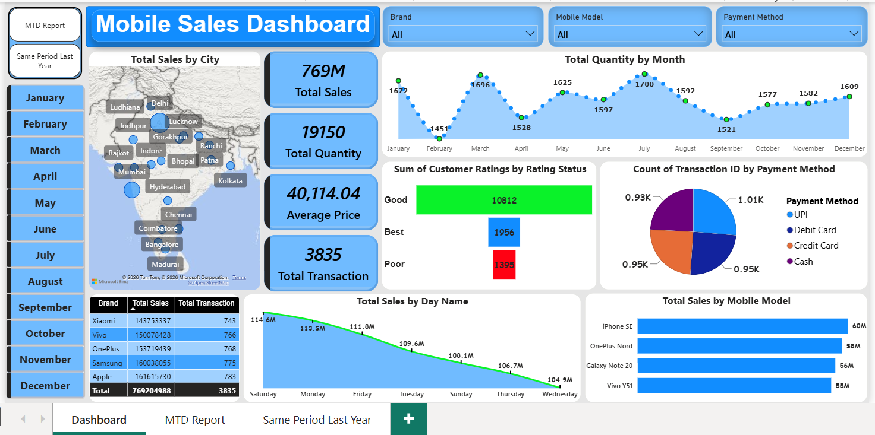
Mobile Sales Analysis Dashboard
Power BI Portfolio Project
Prepared By
Anup Sharma
Aspiring Data Analyst

Slide 2
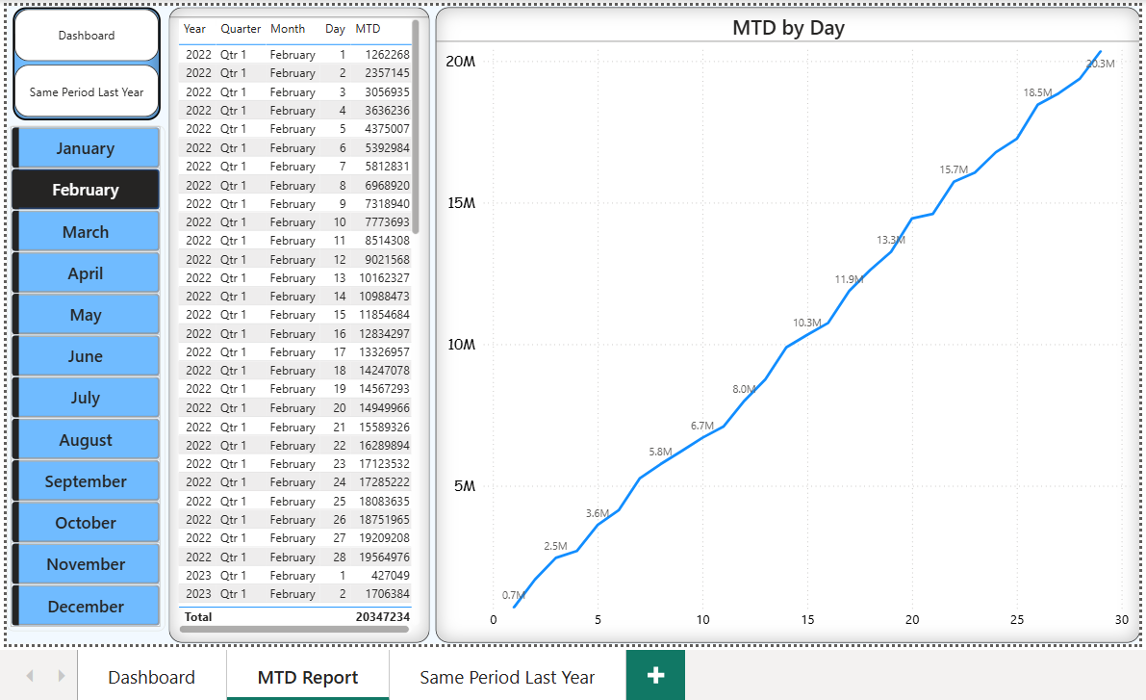
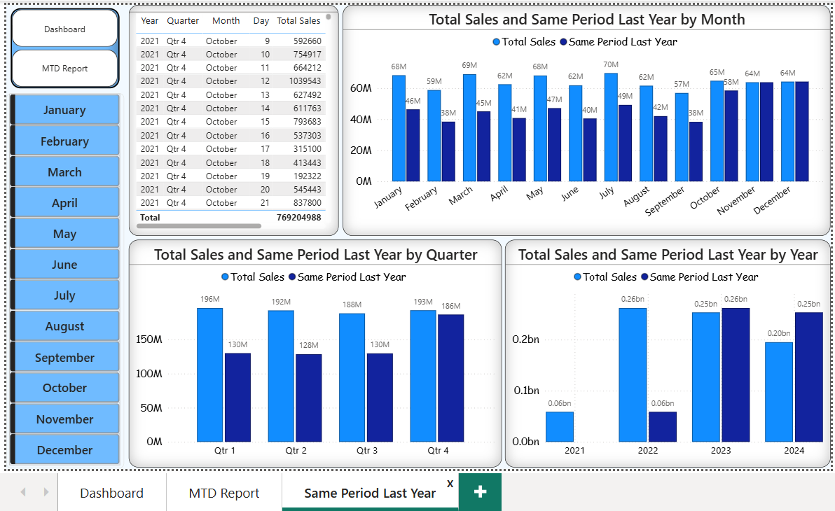
Project Introduction
This project presents an interactive Power BI dashboard developed to analyze mobile sales data. The dashboard enables users to monitor sales performance, compare trends over time, evaluate customer ratings, and analyze payment methods using interactive filters.
Dashboard Pages:
Executive Dashboard
Month-to-Date (MTD) Analysis
Same Period Last Year (SPLY) Analysis

Slide 3
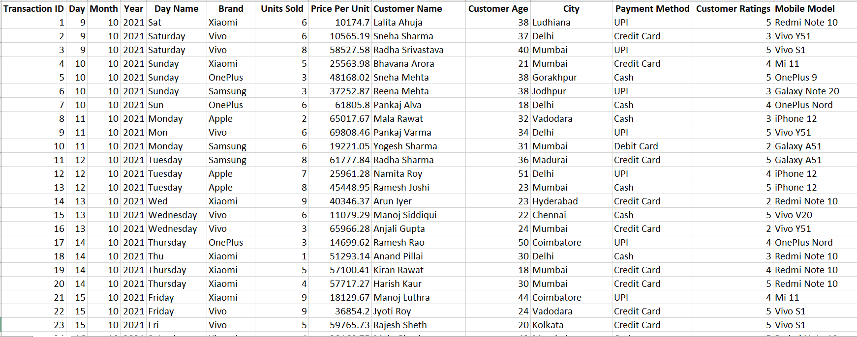
Dataset Overview
Dataset Includes:
Brand
Mobile Model
City
Total Sales
Units Sold
Customer Rating
Payment Method
Transaction Date
Item
Description
Source
Excel Dataset
Total Transactions
3,835
Analysis Period
2021–2024
Dashboard Pages
3

Slide 4
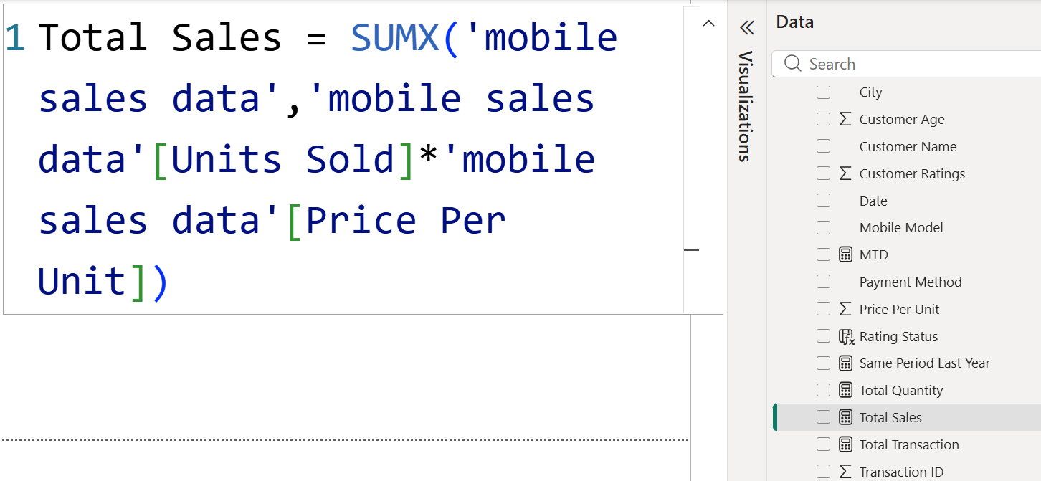
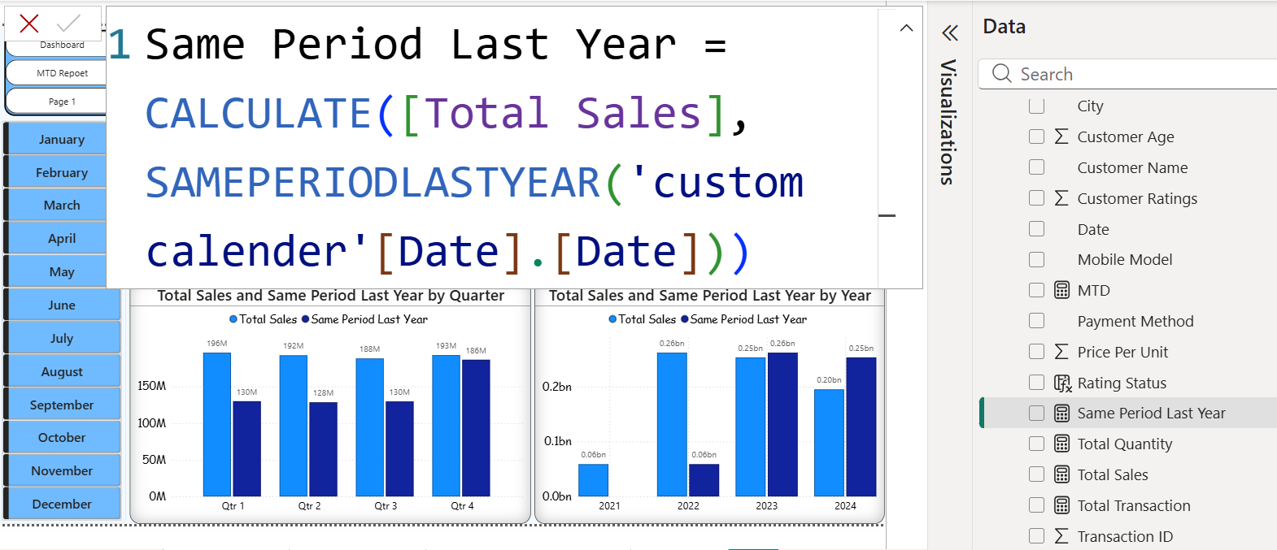
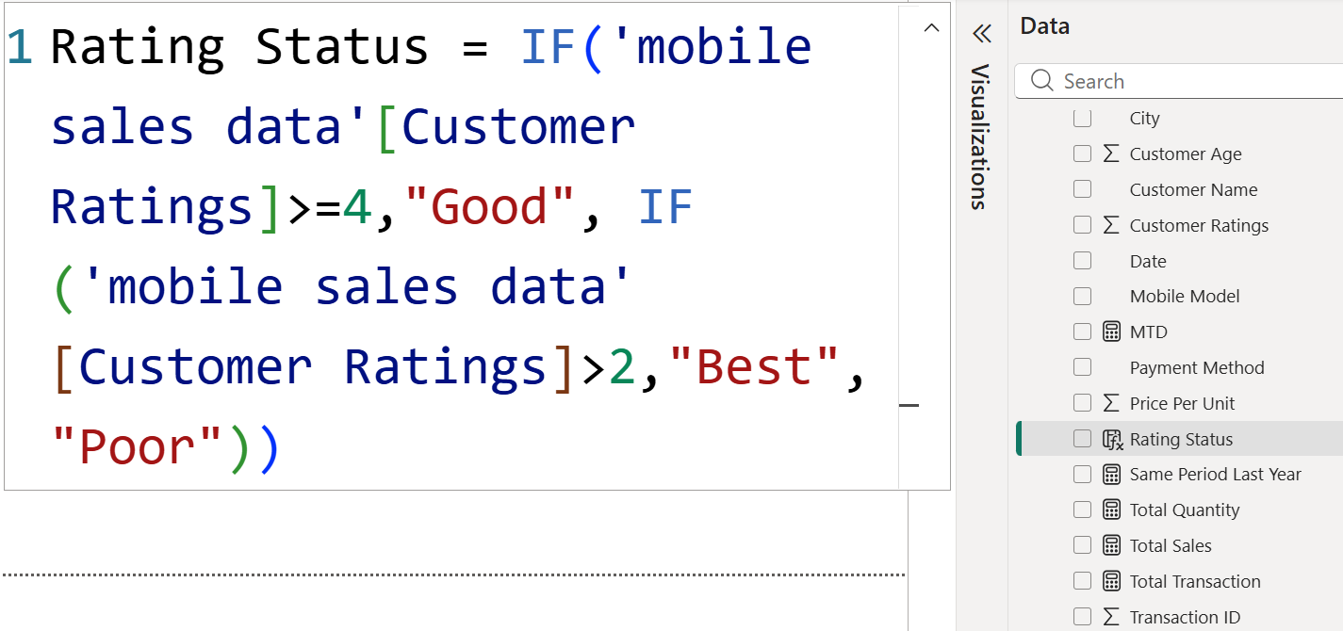
DAX Measures Used
The dashboard uses DAX measures to calculate KPIs and perform Time Intelligence analysis.
KPI Measures
Time Intelligence
Conditional Logic
✔ Total Sales
✔ Total Quantity
✔ Total Transaction
✔ MTD
✔ Same Period Last Year
✔ Rating Status

Slide 5
Executive Dashboard
Key KPIs:
Total Sales
Total Quantity
Average Price
Total Transactions
Dashboard Analysis:
City-wise Sales
Monthly Sales Trend
Customer Ratings
Payment Method Analysis
Brand Performance
Top Mobile Models

Slide 6
Dashboard Features
Interactive Features:
Filters:
Brand
Mobile Model
Payment Method
Month
Visualizations Used:
KPI Cards
Map
Line Chart
Pie Chart
Bar Chart
Table

Slide 7
MTD Analysis
Month-To-Date Analysis
Purpose:
Track cumulative sales performance throughout the selected month.
Highlights:
Daily Sales Trend
Running Monthly Sales
Monthly Performance Monitoring

Slide 8
Same Period Last Year Analysis
Purpose:
Compare current sales performance with the corresponding period of the previous year.
Analysis:
Monthly Comparison
Quarterly Comparison
Yearly Comparison

Slide 9
Key Features & Insights
Interactive KPI monitoring
Dynamic filtering by Brand, Model, Payment Method, and Month
City-wise sales analysis through map visualization
Month-to-Date (MTD) sales tracking
Year-over-Year sales comparison using SAMEPERIODLASTYEAR
Customer rating and payment method analysis
Responsive dashboard with cross-filtering across visuals

Slide 10
Conclusion
This dashboard transforms raw mobile sales data into meaningful business insights through interactive visualizations.
Skills Demonstrated:
Power BI
Power Query
DAX
Data Visualization
Time Intelligence
Business Analysis

